Slide 1
Scaled Agile Framework
Presented by
Dmitro Malikov

Slide 2
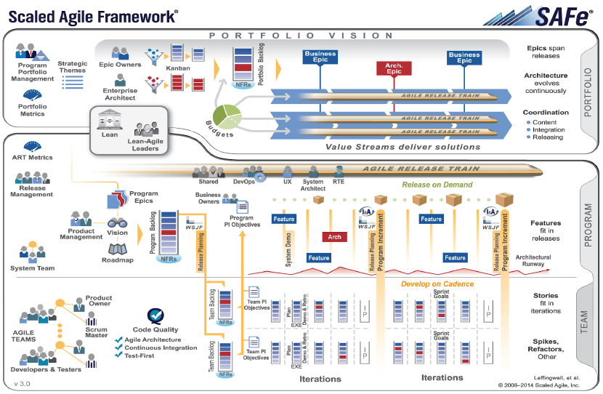
Scaled Agile Framework
Notes:
Scaled Agile Framework (or SAFe) is an Agile software development framework designed by Scaled Agile, Inc. It consists of a knowledge base of integrated patterns intended for enterprise-scale Lean-Agile development. Its proponents consider SAFe to be scalable and modular, allowing an organization to apply it in a way that suits its need.

Slide 3
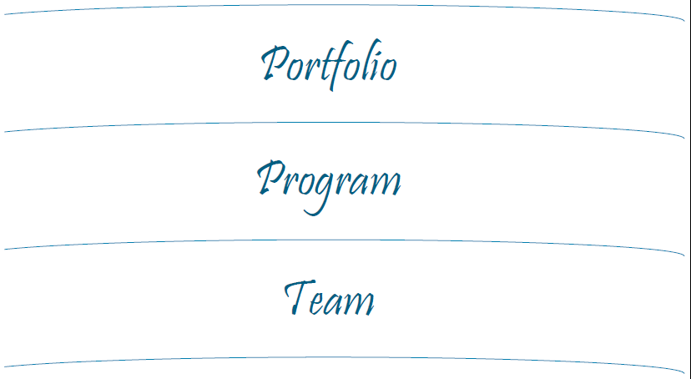
SAFe respects the standard abstraction layers
Notes:
SAFe synchronizes alignment, collaboration, and delivery for large numbers of agile teams. It supports both software and systems development, from the modest scale of under 100 practitioners to the largest software solutions and complex cyber-physical systems; systems that require thousands of people to create and maintain. SAFe was developed in the field, based on helping customers solve their most challenging scaling problems. SAFe leverages three primary bodies of knowledge: Agile development, Lean product development, and systems thinking

Slide 4
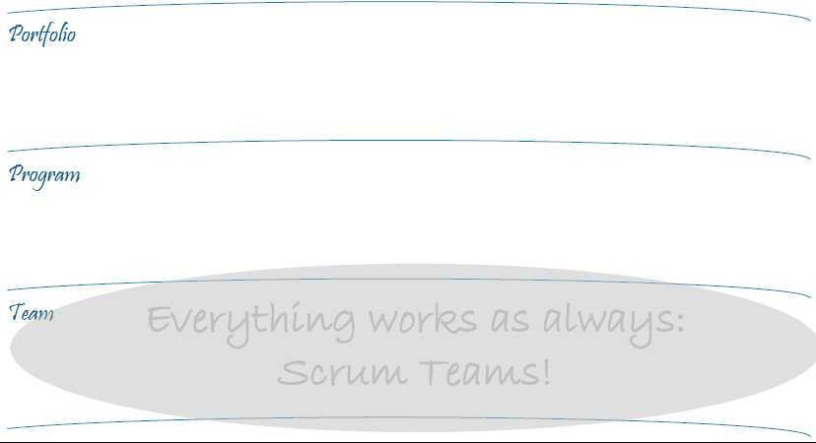
At team level, everything works as always: Scrum teams

Slide 5
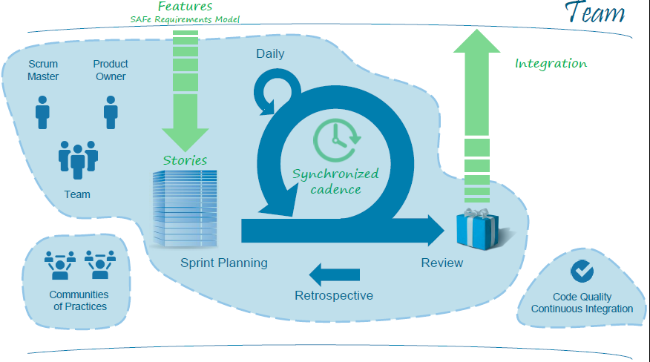
As always….with three differences

Slide 6
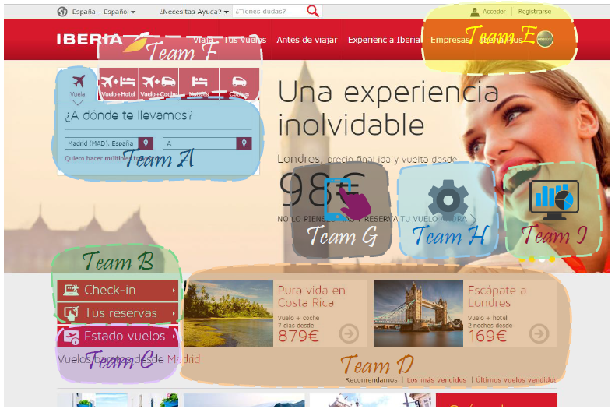
Example of complex software ecosystem

Slide 7
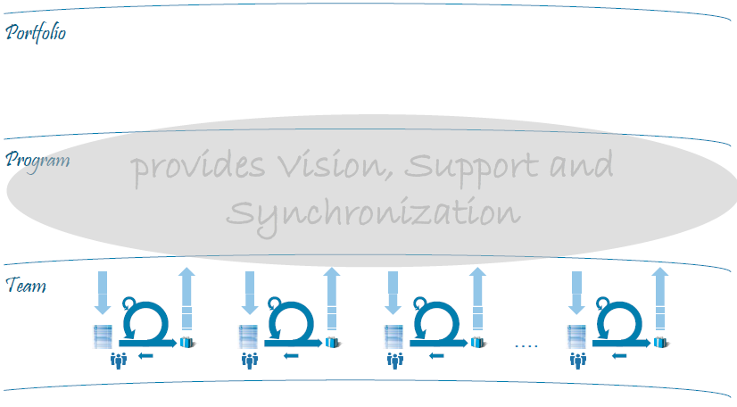
At program level, provides vision, support and synchronization

Slide 8
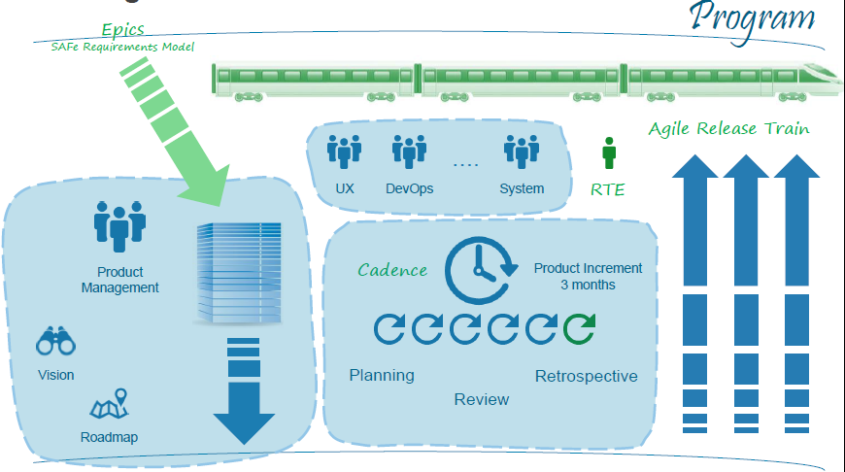
Vision, Support and Synchronization at Program level

Slide 9
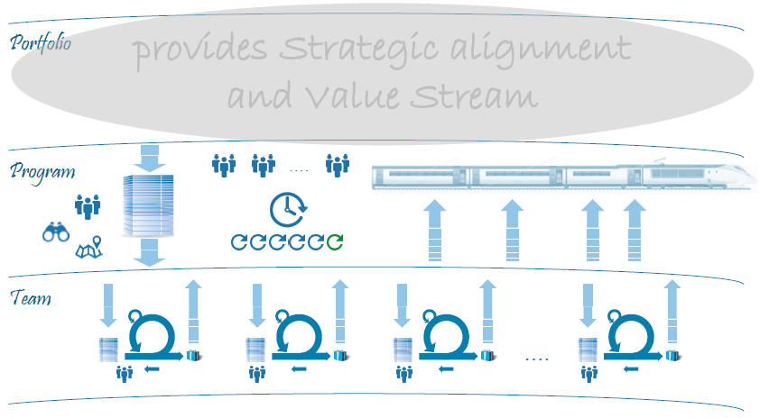
At portfolio level, provides strategic alignment and value stream

Slide 10
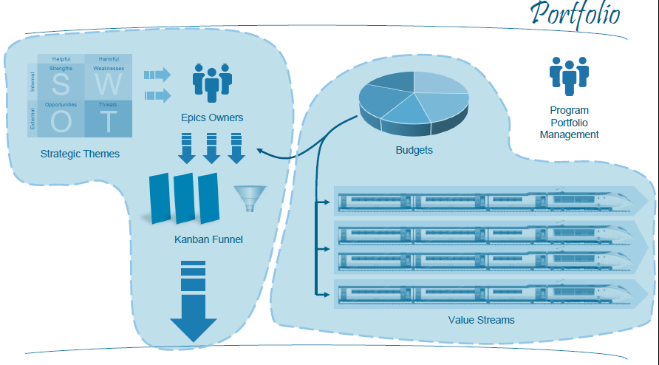
Strategic alignment and Value Stream at Portfolio level

Slide 11
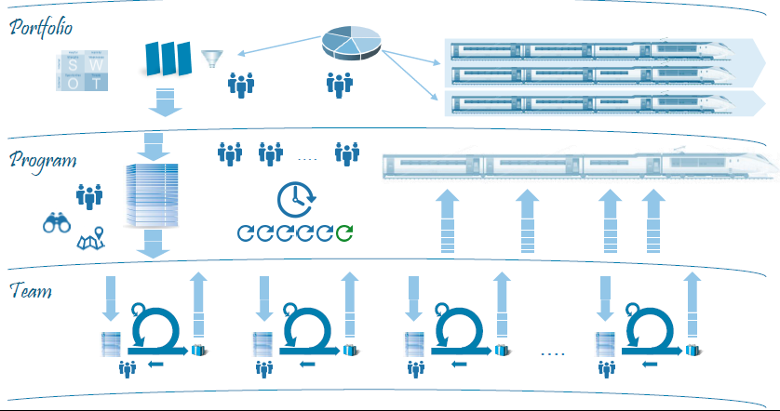
The big picture

Slide 12
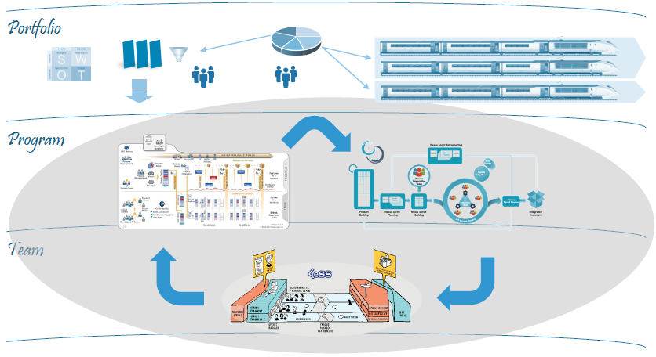
Last call… Complete your toolbox

